Slide 1
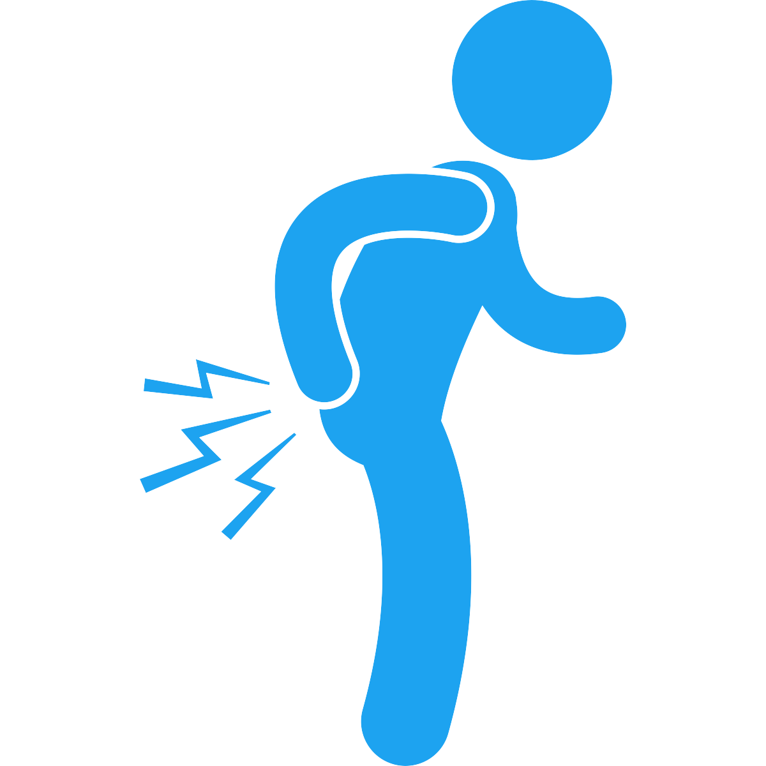

Title: The Evolutionary Roots of Back Pain: A Bipedal Burden
Name: Josh Manchester
Course/Class: ANTH 3380 Evolutionary Medicine
Date: 15 January 2025

Slide 2
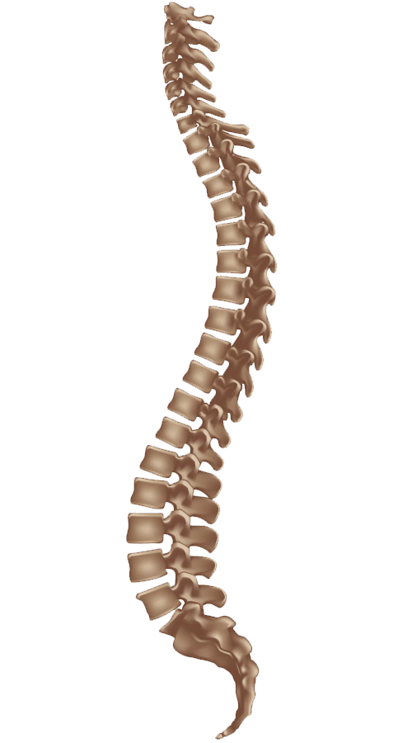
Research Question/Topic
Research Question: How does the evolution of the human spine for bipedalism contribute to the prevalence of back pain in modern populations?

Slide 3

Summary of Literature Review
Evolution of the Spine: Johanson & Edgar (2010) and Lieberman (2013)
Biomechanical Vulnerabilities: Schilling et al. (2005)
Disc & Endplate Degeneration: Farshad-Amacker et al. (2014)
Evolutionary Mismatch: Lieberman (2013)
Foot-Spine Interplay: McNutt et al. (2018)

Slide 4

Traditional vs. Evolutionary Medicine
Traditional Medicine Approach
Focus on symptom management (pain relief, medication, surgery)
Standard physical therapy or ergonomic interventions
Evolutionary Medicine Approach
Understanding bipedal adaptations and inherent spinal weaknesses
Emphasis on posture, movement patterns, and lifestyle changes informed by evolutionary history

Slide 5

Key Evolutionary Factors
Lumbar Lordosis: Facilitates upright walking but increases stress on lower vertebrae.
Sedentary Lifestyles: Mismatch between ancestral activity levels and modern sitting.
Genetic & Environmental Interplay: Mechanical stress plus genetic predispositions.

Slide 6

Remaining Questions
Genetic Markers: Which individuals are at the highest risk based on spinal or foot morphology?
Optimal Movement Patterns: How can we better define and measure ‘ancestral’ movement to reduce back pain?
Integrating Disciplines: How can evolutionary biologists, clinicians, and biomechanists collaborate to create holistic interventions?

Slide 7


Future Directions
Interdisciplinary Research: Bridging paleoanthropology, biomechanics, and clinical practice (McNutt et al., 2018).
Preventive Measures: Encouraging active, varied movement and ergonomic improvements.
Tailored Treatments: Personalized exercise programs targeting weak links (Schilling et al., 2005).

Slide 8
Conclusion
Summary: Bipedal evolution + modern lifestyles = High back pain prevalence
Significance: Evolutionary understanding can inform better prevention and treatment
Final Thought: Addressing both biology and behavior is key to reducing the burden of back pain

